Slide 1
Romans 2:1-16

Slide 2
2 Therefore you have no excuse, O man, every one of you who judges. For in passing judgment on another you condemn yourself, because you, the judge, practice the very same things. ² We know that the judgment of God rightly falls on those who practice such things. ³ Do you suppose, O man—you who judge those who practice such things and yet do them yourself—that you will escape the judgment of God? ⁴ Or do you presume on the riches of his kindness and forbearance and patience, not knowing that God’s kindness is meant to lead you to repentance? ⁵ But because of your hard and impenitent heart you are storing up wrath for yourself on the day of wrath when God’s righteous judgment will be revealed.

Slide 3
⁶ He will render to each one according to his works: ⁷ to those who by patience in well-doing seek for glory and honor and immortality, he will give eternal life; ⁸ but for those who are self-seeking and do not obey the truth, but obey unrighteousness, there will be wrath and fury. ⁹ There will be tribulation and distress for every human being who does evil, the Jew first and also the Greek, ¹⁰ but glory and honor and peace for everyone who does good, the Jew first and also the Greek. ¹¹ For God shows no partiality.

Slide 4
¹² For all who have sinned without the law will also perish without the law, and all who have sinned under the law will be judged by the law. ¹³ For it is not the hearers of the law who are righteous before God, but the doers of the law who will be justified. ¹⁴ For when Gentiles, who do not have the law, by nature do what the law requires, they are a law to themselves, even though they do not have the law. ¹⁵ They show that the work of the law is written on their hearts, while their conscience also bears witness, and their conflicting thoughts accuse or even excuse them ¹⁶ on that day when, according to my gospel, God judges the secrets of men by Christ Jesus.

Slide 5
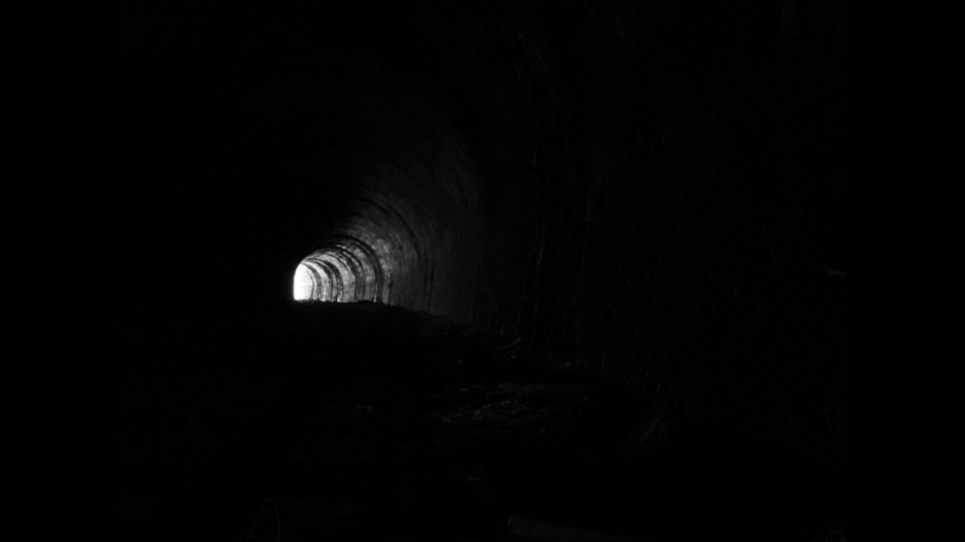

Slide 6
The wrath of God is being revealed...
...because humanity have turned their back on God.
Godlessness / Idolatry
A Downwards Spiral
Unrighteousness / Immorality / Depravity
The wrath of God – handed over to all manner of unrighteousness
homosexuality
a debased mind
Evil
covetousness
depravity
envy
murder
strife
deceit
maliciousness
gossips
slanderers
haters of God
insolent
haughty
boastful
inventors of evil
disobedient to parents
foolishheartless
ruthless

Slide 7
The Day of The Lord
There is a day of judgment...
The Lord our God will require a reckoning
The Day of Wrath
⁶He will render to each one according to his works...
God loves it when we do good. He hates it when we do evil
Very few people are so completely evil, that they never do any good
But none of us are so completely good, that we never do any evil
No amount of good can ever make up for any evil we have done
None of us have an excuse. We are not good enough. We need Jesus
If we can recognise sin and unrighteousness in others, there is no excuse for not recognising it in ourselves
Deluded hopes of escaping the judgment of God:

Slide 8
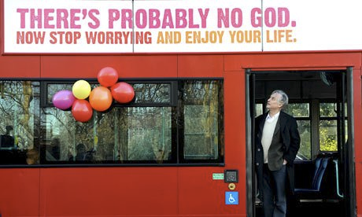
In London, a group of committed atheists
paid for these bus billboards

Slide 9
The Day of Judgment – The Lord will require a reckoning
⁶He will render to each one according to his works...
God loves it when we do good. He hates it when we do evil
Very few people are so completely evil, that they never do any good
But none of us are so completely good, that we never do any evil
None of us have an excuse. We are not good enough. We need Jesus
If we can recognise sin and unrighteousness in others, there is no excuse for not recognising it in ourselves
Deluded hopes of escaping the judgment of God:
The Godless – No judgment because God doesn’t exist.
The Self-righteous – Confident they are good enough to escape judgment
The religious – trusting in some empty religion or belief about God
The only way to escape judgment – repent and believe
God’s patient, kindness / forbearance is meant to lead us to repentance
Those who don’t repent, are storing up wrath for “The Day of Wrath”

